Slide 1
Chapter 11
Learning Objectives:
Domain 4: Communication and Network Security
4.1 Implement secure design principles in network architectures
4.1.1 Open System Interconnection (OSI) and Transmission Control Protocol/Internet Protocol (TCP/IP) models
4.1.2 Internet Protocol (IP) networking
4.1.3 Implications of multilayer protocols
4.1.4 Converged protocols
4.1.5 Software-defined networks
4.1.6 Wireless networks

Slide 2
Chapter 11
Learning Objectives:
Domain 4: Communication and Network Security
4.2 Secure network components
4.2.1 Operation of hardware
4.2.2 Transmission media
4.2.3 Network Access Control (NAC) devices
4.2.4 Endpoint security
4.2.5 Content-distribution networks

Slide 3
History of the OSI Model
A protocol is asset of rules and restrictions that define how data is transmitted over a network medium
In the early 1970s, ISO developed the Open System Interconnection Model to standardize communication protocols; ISO 7498
Prior to the OSI model, DARPA developed the TCP/IP model
Just a reference model, but essential to the CISSP exam
Serves as an abstract framework for how protocols should function in an ideal world on ideal hardware

Slide 4
OSI Functionality
Divides networking tasks into seven distinct layers
It is an open network architecture guide for network product vendors
The real benefit of the OSI model is its expression of how networking actually function

Slide 5
Encapsulation/De-encapsulation
Encapsulation is the addition of header, and possible a footer, to the data received each layer above before it’s hands off the layer below
The inverse process is called de-encapsulation

Slide 6
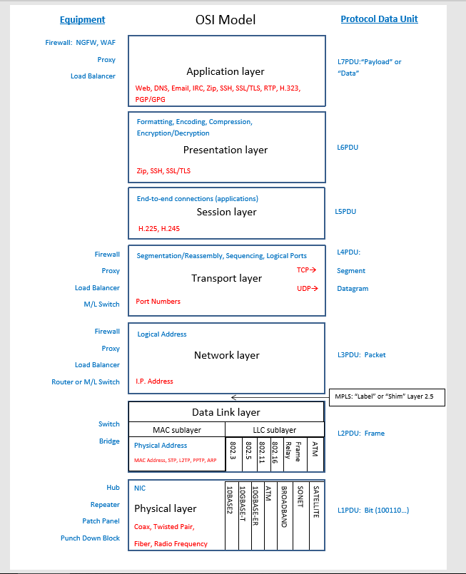
OSI Layers
Physical Layer
Data Link Layer
Network Layer
Transport Layer
Session Layer
Presentation Layer
Application Layer

Slide 7
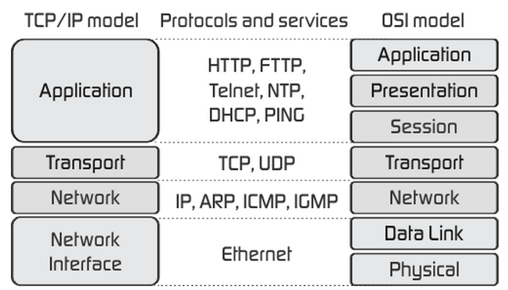
TCP/IP Model

Slide 8
TCP/IP Protocol Suite Overview
Not just a single protocol, but a protocol stack comprising dozens of individual protocols
A platform-independent protocol based on open standards
TCP/IP can be secured using VPN links
PPTP
L2TP
SSH
OpenVPN
IPsec

Slide 9
Transport Layer Protocols
TCP – connection-oriented; full duplex protocol
UDP – connectionless; simplex protocol
Port numbers: 0 - 65,535
Well-known ports: 0-1023
Registered ports: 1024-49151
Dynamic/Private/Random/Ephemeral ports: 49152-65535

Slide 10
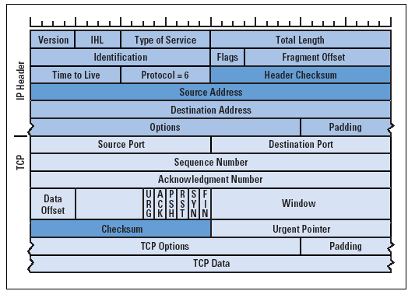
Transport Layer Protocols
3-way handshake:
SYN
SYN/ACK
ACK
TCP header flags:
Table 11.2 (page 456)

Slide 11
Network Layer Protocols and IP Networking Basics
IPv4 vs IPv6
IPv4 – 32 bit, dotted-decimal
IPv6 – 128 bit, hexadecimal
IP classes
ICMP – ping, traceroute, pathping
IGMP - multicasting
ARP – IP ⬄ MAC mapping

Slide 12
Common Application Layer Protocols
Telnet
FTP
TFTP
SMTP
POP3
IMAP4
DHCP
HTTP
SSL/TLS
Line Print Daemon
X Window
GUI API for command-line OSs
Network File System
File sharing between dissimilar systems
SNMPv3
Page 462 and 463

Slide 13
Implications of Multilayer Protocols
TCP/IP is a multilayer protocol
Many benefits; encapsulation
Some not so nice benefits; encapsulation
Encapsulating one protocol inside another could allow covert channels
Unbounded encapsulation support; the ability to jump between VLANs; VLAN hopping
Distributed Network Protocol (DNP3) – primarily used in the electric and water utility and management industries; ICS and SCADA

Slide 14
TCP/IP Vulnerabilities
Improperly implemented TCP/IP stacks in various OSs are vulnerable to buffer overflows, SYN flood attacks, DDoS attacks, fragment attacks, oversized packet attacks, spoofing attacks, man-in-the-middle attacks, hijack attacks, and coding attacks
Subject to passive monitoring attacks

Slide 15
Domain Name System
Addressing and numbering
MAC address – hardware address, physical address, Layer 2 address, permanent address
IP address - logical address, “temporary” address
Domain name – human-friendly name
Domain Name System and ARP were developed to interchange or resolve between domain names and IP addresses or IP addresses and MAC addresses
Three main parts:
Top-level domain (TLD)
Registered domain name
Subdomain or hostname

Slide 16
Domain Name System
The primary authoritative name server hosts the original zone file for the domain
The secondary authoritative name server can be used to host read-only copies for the zone file
DNS common resource records
See page 467
Domain Name System Security Extension (DNSSEC)
A security improvement to the existing DNS infrastructure
Provide reliable authentication between devices during DNS operations
Uses digital certificates to perform mutual authentication
The goal is to prevent DNS abuses

Slide 17
DNS Poisoning
Can take place at any of the steps involved in name resolution, but is easiest is to corrupt the HOSTS file or the DNS server query
Deploy a rogue DNS server
Perform DNS poisoning
Alter the HOSTS file
Corrupt the IP configuration
Use proxy falsification
Pharming; similar to DNS poisoning; redirect attack often through phishing attack

Slide 18
Domain Hijacking
Aka domain theft
The malicious action of changing the registration of a domain name without the authorization of the valid owner
Accomplished through stealing login credentials, using XSRF, hijacking a session, using MitM or exploiting a flaw in the domain registrar’s system

Slide 19
Converged Protocols
Merging of specialty or proprietary protocols with standard protocols such as those from TCP/IP
Primary benefit: use existing TCP/IP supporting network infrastructure to host special or proprietary services without the need for unique deployments of alternate networking hardware.
Fibre Channel over Ethernet (FCoE)
Multiprotocol Label Switching (MPLS)
Internet Small Computer System Interface (iSCSI)
Voice over IP (VOIP)
Software-Defined Networking (SDN)

Slide 20
Content Distributed Networks
Content Distributed Network or Content Delivery Network
A collection of resource services deployed in numerous data centers across the Internet in order to provide low latency, high performance, and high availability of hosted content
Provide desired multimedia performance quality demanded by customers through the concept of distributed data hosts
Results in a type of geographical load-balancing
Examples: CloudFare, Akamai, Amazon CloudFront, CacheFly, and Level 3 Communications

Slide 21
Wireless Networks
Securing Wireless Access Points
Adjust power settings
Infrastructure mode
Securing the SSID
Disable the beacon frame for the SSID; but can still be detected
Use WPA2
Conducting a Site Survey
Using Security Encryption Protocols
WEP
WPS
WPA
WPA2

Slide 22
Wireless Networks
Using Security Encryption Protocols
WEP
WPS
WPA
WPA2
802.1X/EAP
PEAP
LEAP
MAC Filter
TKIP
CCMP

Slide 23
Wireless Encryption Standards
 |  | Authentication | Encryption | Integrity | Standard
WEP |  | Pre-Shared Key (PSK) | 24-bit I.V. + 40-bit key RC-4 cipher | CRC32 | 802.11
WPS |  | Push-button | 24-bit I.V. + 40-bit key RC-4 cipher | CRC32 | 802.11
 |  | PIN
WPA | Personal | PSK | 48-bit I.V + PSK =128-bit key RC-4 | TKIP (MIC) | 802.11i
 | Enterprise | 802.1X
WPA2 | Personal | PSK | 48-bit I.V. + PSK = 256-bit key AES-CCMP | CBC-MAC | 802.11i
 | Enterprise | 802.1X

Slide 24
Determining Antenna Placement
Guidelines:
Use a central location
Avoid solid physical obstructions
Avoid reflective or other flat metal surfaces
Avoid electrical equipment
Antenna types
Omnidirectional
Base antenna or “rubber duck”
Directional
Yagi, cantenna, panel, and parabolic
Adjusting power levels
When adjusting power levels, make minor adjustments
After each adjustment, reboot the WAP before performing another site survey

Slide 25
WPS
A security standard for wireless network
Simplifies the effort involved in adding new clients to a well-secured wireless network
Push-button or PIN access methods
Susceptible to brute-force attacks

Slide 26
Using Captive Portals
Redirects newly connected wireless web clients to a portal access control page
May require the user to input payment information, provide logon credentials, or input an access code
Also used to display acceptable use policy, privacy policy, and tracking policy to the user
Often used at hotels, restaurants, bars, airports, libraries, education centers, etc.

Slide 27
General Wi-Fi Security Procedure
Change the default administrator password
Enable or disable SSID broadcast
Change the SSID to something unique
Enable MAC filtering
Consider static IP addresses
Use the strongest authentication and encryption
Treat wireless as remote access and separate using a firewall
Requires all transmission between wireless clients and WAPs to be encrypted

Slide 28
Wireless Attacks
War Driving
War Chalking
Replay
IV
Rogue Access Points
Evil Twin

Slide 29
Secure Network Components
Intranet – a private network designed to host the same information services found on the internet
Extranet – a cross between the internet and an intranet; a section of the organization’s network that has been sectioned off so that I acts as and intranet for the private network but also serves information to the public internet; often reserved for specific customers
A DMZ is a public extranet
Network Segmentation can:
Boosting performance
Reducing Communications Problems
Provide Security

Slide 30
Network Access Control
NAC is concept of controlling access to an environment through strict adherence to and implementation of security policy
Goals:
Prevent/reduce zero-day attacks
Enforce security policy throughout the network
Use identities to perform access control
Goals can be achieved through the use of strong detailed security policies that define all aspects of security control, filtering, prevention, detection, and response for every device from client to server and for internal or external communication
Acts as an automated detection and response system
Can be implemented with a preadmission philosophy or a post admission philosophy or both

Slide 31
Firewalls
Firewalls are essential tools in managing and controlling network traffic
Typically deployed between a private network and a link to the internet, but can deployed between departments within an organization
Filters traffic based on a set of rules or access control lists
Blocks or filters traffic, but does not block viruses or malicious code transmitted through authorized connections
Only one part of overall security solution

Slide 32
Firewalls
Several types of firewalls:
Static Packet-Filter Firewalls
Examines data from a message header
First generation firewalls
Application-Level Gateway Firewalls
Also called a proxy firewall; filters traffic based on the internet service
Second generation firewalls
Circuit-level Gateway Firewalls
Establish communication sessions between trusted partners
Manage communications based on the circuit, not the content
Second generation firewalls
Stateful Inspection Firewalls
Dynamic packet filtering firewalls; evaluate the state or context of the traffic
Able to grant a broad range of access for authorized users and activities
Third generation firewalls
Deep Packet Inspection Firewalls
Filtering mechanism that operates typically at the Application Layer; filters content rather than header
Next-Generation Firewalls
Composed of several features in addition to a firewall; IDS/IPS, SSL/TLS proxy, web filtering, QoS management bandwidth throttling, NAT, VPN gateway, and antivirus

Slide 33
Multihomed Firewalls
Some firewalls have more than one interface
A bastion host is a computer or appliance that is exposed on the internet and has been hardened by removing all unnecessary elements
A screened host is a firewall-protected system logically positioned just inside a private network; screens traffic inbound to the network and protects the identity of internal clients

Slide 34
Firewall Deployment Architectures
Single-tier
Useful against generic attacks; offers minimal protection
Two-tier
Two different designs
One uses a firewall with three or more interfaces and separates private network from the DMZ using interfaces
The second uses two firewalls in series allowing public accessibility
Three-tier
Deployment of multiple subnets between the private network and the internet separated by firewalls
The outer subnet is usually a DMZ; the middle subnet can server as a transaction subnet; the third subnet can support the private network
See page 491

Slide 35
Endpoint Security
The concept that each individual device must maintain local security whether or not its network or telecommunication channels also provide or offer security
Traditional security depended on network border sentries
Firewalls, proxies, centralized virus scanner, and IDS/IPS
This is no longer considered best business practice
Firewalls, proxies, centralized virus scanner, and IDS/IPS
End point security should be viewed a an aspect of the effort to provide sufficient security on each individual host

Slide 36
Secure Operation of Hardware
Repeaters, Concentrators, and Amplifiers – Layer 1 devices
Hubs – Layer 1
Modems – traditional landline modems
Bridges – Layer 2; connects two networks; store-and-forward device
Switches – Layer 2; directs traffic directly to host based on MAC address
Routers – Layer 3; routes traffic based on IP address; routing protocols
Brouters – combination device of router and bridge; attempts to route first, then defaults to bridging
Gateways – connects networks that are using different network protocols; responsible for transferring traffic from one network to another by transforming the format of that traffic
Proxies – serves as mediators, filters, caching servers and NAT/PAT servers
LAN extenders – remote access, multilayer switch used to connect distant network over WAN links

Slide 37
Cabling, Wireless, Topology, Communications, and Transmission Media Technology
Transmission Media
Coaxial Cable (coax)
Internal; 10Base2 and 10Base5
External; broadband cable
Baseband and Broadband Cables
Baseband: transmits only a single signal at a time
Broadband: transmit multiple signals simultaneously
Twisted Pair
UTP
STP
Conductors
Copper is resistant to the flow of electrons; results in degradation of the signal strength and quality over the length of the cable

Slide 38
Network Topologies
Ring Topology
Connects clients or nodes in a ring fashion
Token based; 802.5 (Token Ring)
Bus Topology
Connects each nodes to a trunk or backbone cable
Prone to collisions (CSMA/CD)
Two types: linear and tree (page 502)
Star Topology
Employs a centralized connection device
Generally, a central hub or switch is a SPOF
Physical topology and logical topology do not have to match
Mesh Topology
Connects systems to other system using numerous path
Full
Partial

Slide 39
Wireless Communications and Security
General Wireless Concept
Transmits data over radio frequencies
900 MHz, 2.4 GHz, and 5 GHz
Frequency Hopping Spread Spectrum (FHSS) – transmits data in a series while constantly changing the frequency
Direct Sequence Spread Spectrum (DSSS) – employs all the available frequencies simultaneously
Orthogonal Frequency-Division Multiplexing (OFDM) – employs a digital multicarrier modulation scheme

Slide 40
Cell Phones
Phones connect to cell towers and directs calls based on telecommunications carriers infrastructure
Not all cell phone traffic is voice
Communications over a cell phone provider’s network are not necessarily secure

Slide 41
Bluetooth (802.15)
Personal Area Network (PAN)
2.4 GHz
Pairing
Bluejacking – usually one-way hacking; sending data only
Bluesnarfing – two-way hacking; stealing data
Bluebugging – grants hackers remote control over the feature and functions of a Bluetooth device
Limited range: 30 feet typically
Encryption, if implemented, is weak

Slide 42
RFID
Radio Frequency Identification
Tracking technology based on the ability to power a radio transmitter using current generated in an antenna when place in a magnetic field
Allow for quick inventory tracking without having to be in direct physical proximity of the device; RFID reader
Stealing data via a RFID reader

Slide 43
NFC
Near-field communications
A standard that establishes short-range radio communications between device in close proximity
A derivative of RFID technology
Commonly found in mobile devices for data-to-data exchange
Subjects to MitM attacks, eavesdropping, data manipulation, and replay attacks

Slide 44
Phones
Cordless phones
900 MHz, 2.4 GHz, or 5 GHz
Handset transmits to a base station via RF signals
Mobile Devices
Smartphones and other devices present an ever-increasing security risk
Support memory cards and USB connections
Loss or theft of a mobile device could mean compromise of personal and/or corporate secrets
Keep nonessential information off the portable device
Not immune to eavesdropping; Stingray

Slide 45
LAN Technologies
Ethernet
Shared-media LAN technology
Broadcast and collision domains
Supports full-duplex using twisted-pair cable
IEEE 802.3
Token Ring
Employs a token-passing technology to control which system can transmit data
Rarely used today due to performance limitations, higher cost compared to Ethernet, and increased difficulty in deployment and management
Multistation Access Unit
FDDI
High-speed token-passing technology that employs two fiber optic rings
Self-healing; expensive

Slide 46
Sub technologies
Analog and Digital
Synchronous and Asynchronous
Baseband and Broadband
Broadcast, Multicast, and Unicast

Slide 47
LAN Media Access
CSMA
Does not address collisions
CSMA/CA
AppleTalk and 802.11
Request-to-Send/Clear-to-Send packets
Attempts to avoid collisions
CSMA/CD
Ethernet
Responds to collisions
Token Passing – performs communications using a digital token; FDDI and Token Ring
Polling – performs communications using a master-slave configuration
Primary system polls each secondary system in turn whether they have a need to transmit data
Synchronous Data Link Control (SDLC)
Attempts to reduce collision using a permission system

Slide 48
Summary
Designing, deploying, and maintaining security on a network requires intimate knowledge about networking
OSI model vs TCP/IP model
Networking equipment
Converged protocols; FCoE, MPLS, VOIP, and iSCSI
Wireless communications; cell phone, Bluetooth, RFID, NFC, and 802.11

